Slide 1


Slide 2
Campaign Objectives: Unlocking growth with sleepwell MAS
Position Sleepwell MAS as the go to dental solution for snoring & mild OSA, increasing clinical adoption, patient awareness, and brand recall across UK dental practices.
Generate 150+ qualified B2B leads (dental practices) within 12 weeks
Onboard 25+ new practices offering Sleepwell MAS as a core service
Achieve 40,000+ brand impressions through digital & email outreach
Register 80+ dentists for CPD-accredited “Sleep in Dentistry” webinar
Secure 20+ patient referrals via in-practice awareness materials
Maintain cost-per-lead under £40 with projected 5x ROI
Strategic Insights
Most UK dentists aren't tapping into sleep therapy yet 45% of adults snore. Sleepwell MAS is more than a device: it’s a profit centre and public health tool. This campaign bridges the gap.

Slide 3
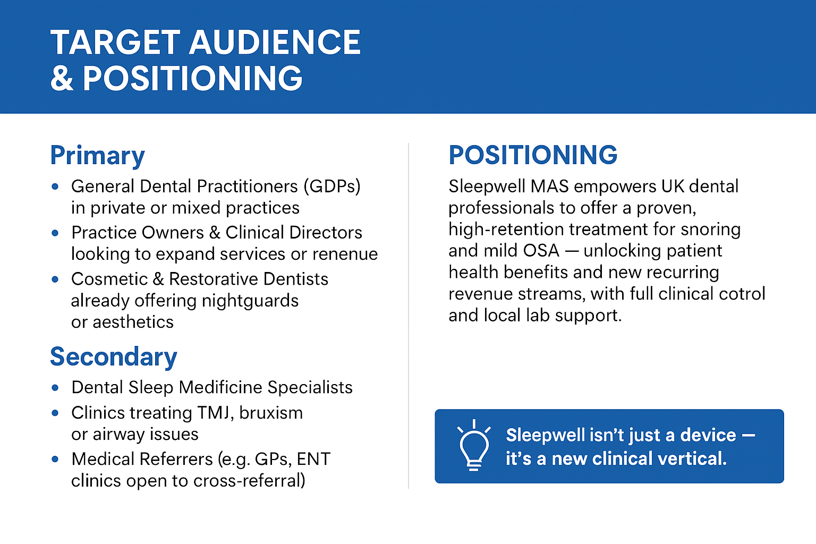

Slide 4
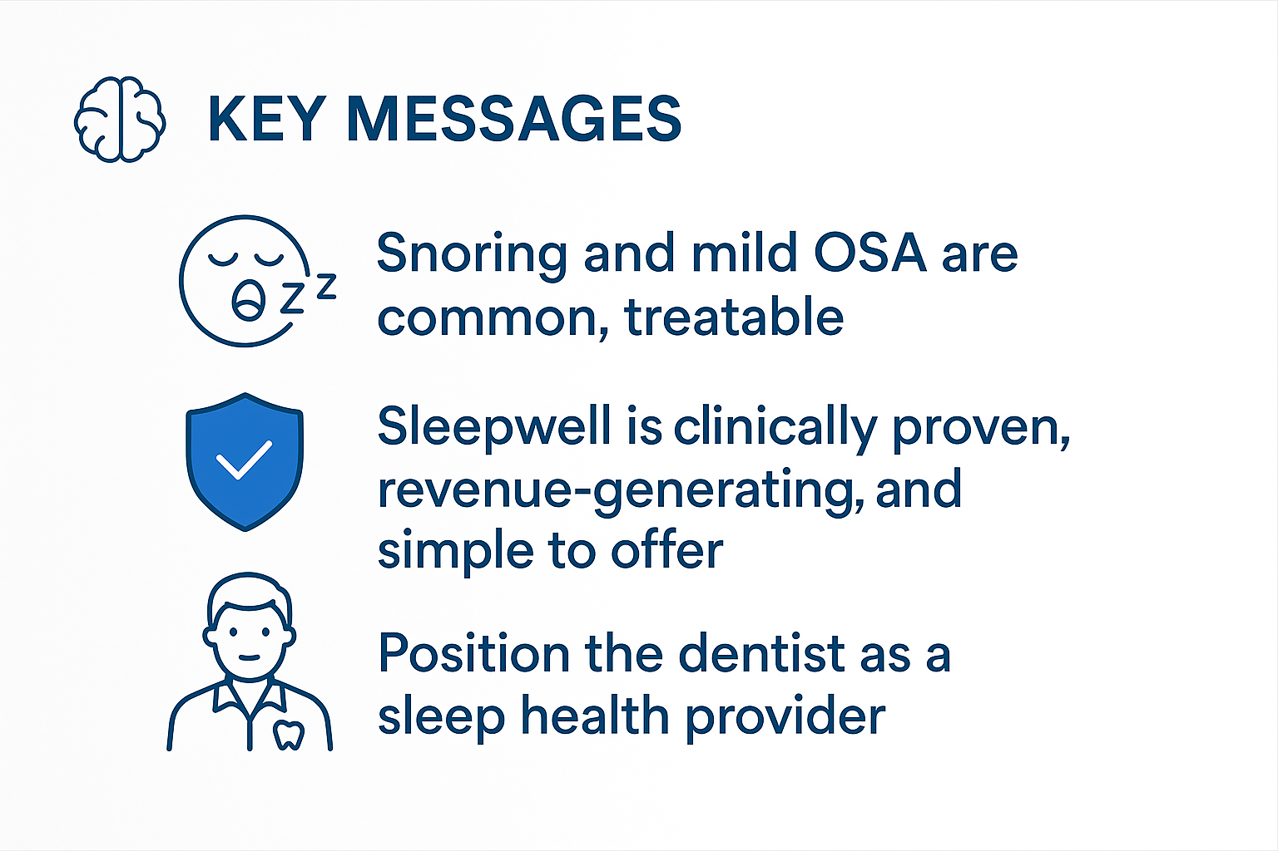

Slide 5
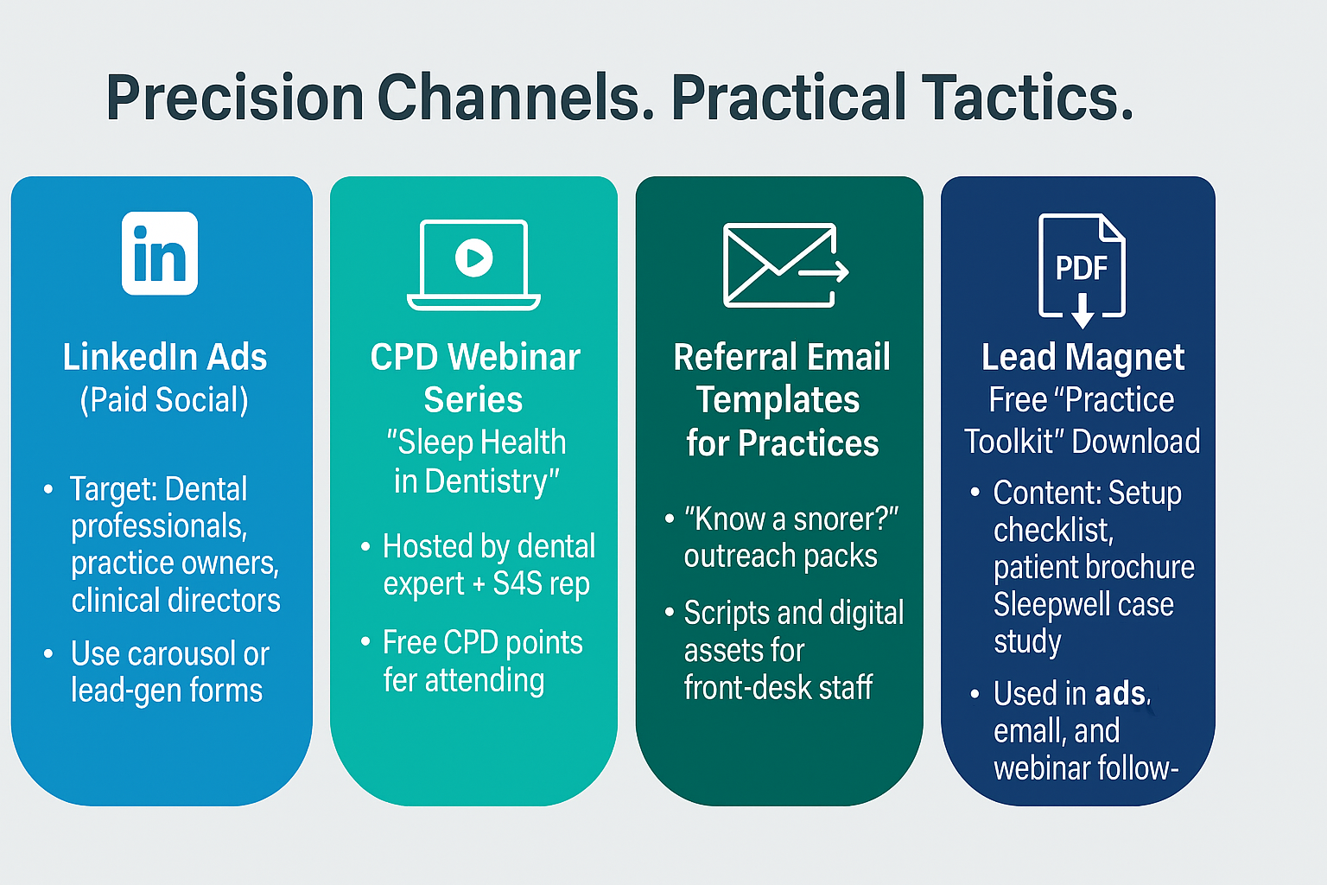

Slide 6

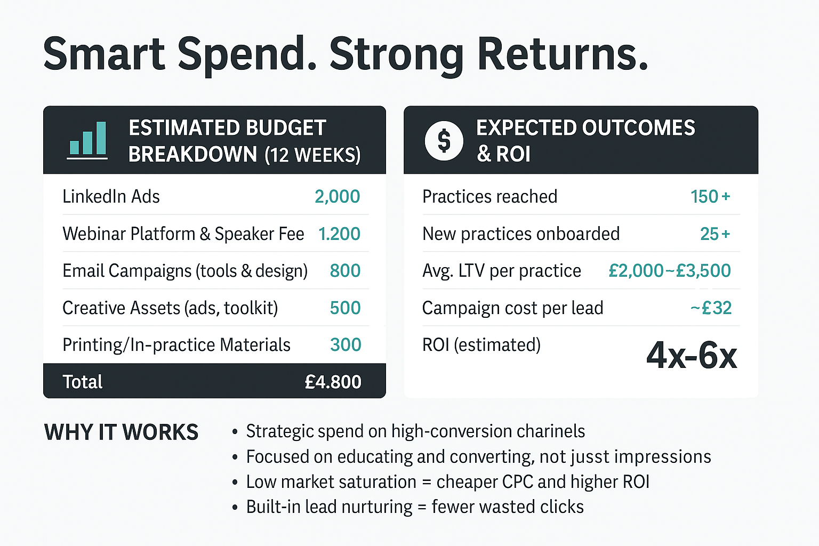

Slide 7

12 Week pilot 9 9 Months plan
Phase 1: Pilot Lunch (Week1- Week12)
Phase 2 Scale & Expand (Month 4-9
Preparation
Finalise creatives, toolkit, and webinar slides
Conversion Push
Host Webinar 2 (case studies + success stories)
Launch high-CTA ads (Sign up / Get Starter Kit)
Soft Lunch
Run teaser LinkedIn ads
Send first webinar invitations
Begin email outreach with referral templates
Increase ad spend to expand reach
Launch regional roadshow or in-practice training events
Publish dentist success stories (case study videos)
Partner with dental associations for co-branded CPD events
Education
Host Webinar 1 – “Sleep Health in Dentistry”
Share lead magnet with attendees
Retarget webinar participants via ads
Optimisation
A/B test ad creatives
Track CPL & ROI
Present results & scaling plan

Slide 8
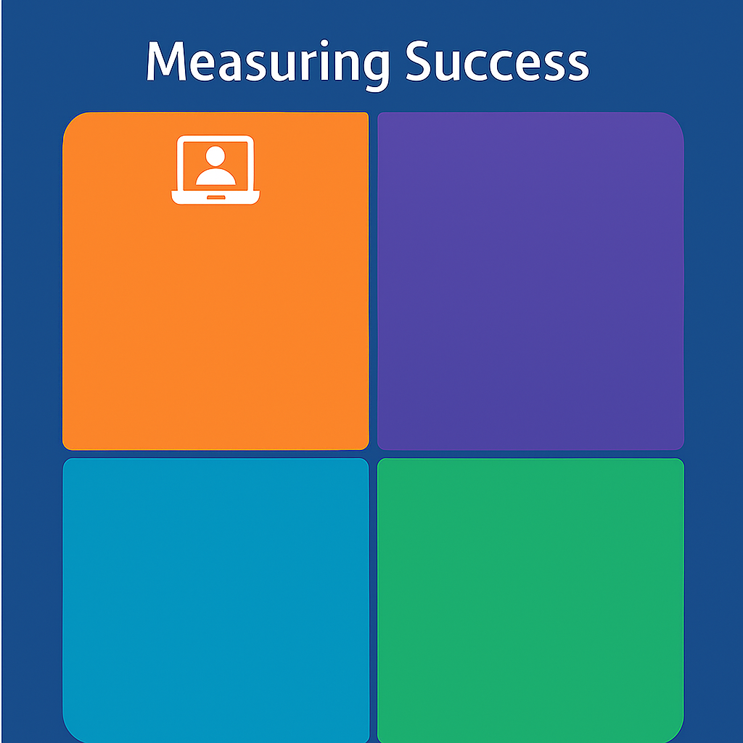



Lead Generation
Engagement
Number of leads captured from LinkedIn ads
Webinar sign-ups & attendance rate
Download rate of Practice Toolkit PDF
Click-through rate (CTR) on ads
Average webinar watch time
Email open rate & click rate
Conversion
ROI
Total campaign cost vs. revenue generated
Lifetime value (LTV) per new practice
ROI multiple (target: 4x–6x)
Number of new practices onboarded
Cost per lead (CPL)
Conversion rate from lead to client

Slide 9

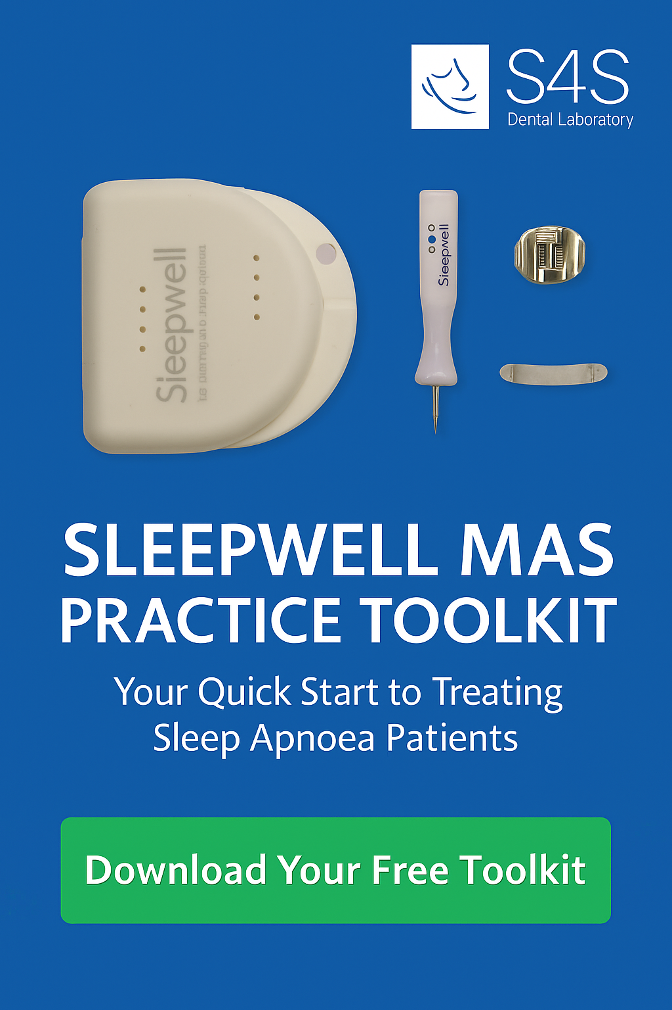

Slide 10


Slide 11
